Slide 1
2. Robot Dynamics
2.1 Newton-Euler formulations
2.2 Lagrange-Euler formulation
2.3 Properties of Dynamic Models
2.4 Dynamics Tutorials
2.5 Neural Network Modelling
- 0 -

Slide 2
2.4.1 Dynamic Tutorials: Problem
Derive the dynamics for the robot shown in Fig.1 using any method that you are comfortable with and compare.
Displacements: and
Forces: and
Masses: and
Fig. 1

Slide 3
2.4.1 Dynamic Tutorials: Problem
2. Suppose the robot is under the influence of gravitational acceleration. Assume the mass of each link is lumped at end of the link. Under the assumption of lumped equivalent masses, derive the Dynamic equation using any method you feel comfortable with.
Fig. 2

Slide 4
2.4.1 Dynamic Tutorials: Problem
Hint:
Find the positions and velocities of and with respect to the base xyz
b) Find the kinetic energy K and the potential energy P
Find the expression for matrix from
Find the Lagrange-Euler Equations
where

Slide 5
2.4.1 Dynamic Tutorials: Problem
3. Suppose that the robot is under the influence of gravitational acceleration. Assume the mass of each link is lumped at the centre of the link. r_{i} denotes the distance from joint i to the centre of mass of link, and l_{i} denotes the length of link i. Under the assumption of lumped equivalent masses, derive the Dynamic equation using any method you feel comfortable with.
Fig. 3

Slide 6
2.4.1 Dynamic Tutorials: Problem
4. Consider the 2 link robot in 3D space, assume that the mass of each link is lumped at end of the link.
i) Under the assumption of lumped equivalent masses, derive the
dynamics of equation.
ii) Is there any possible configurations for 2 link robots?
iii) Can you image the complexity of higher degree of freedom robots?
Fig. 4

Slide 7
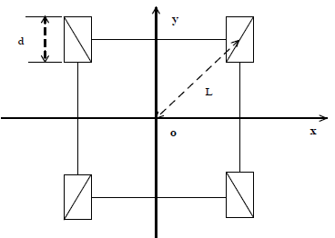





2.4.1 Dynamic Tutorials: Problem
5. For the differential driven wheeled robot shown in Figure 5, where each wheel is driven independently. Forward/backward motion is produced by driving both wheels at the same rate, and turning right/left is achieved by driving the wheels at different rates.
$$ω_{1}$$
$$ω_{2}$$
(i) Give two different sets of generalized coordinates for the robot, and clearly indicate the type of joints.
$$ω$$
$$ω_{3}$$
$$ω_{4}$$
Fig. 5
(ii) Find its kinetic energy, and Langrange-Euler equations.

Slide 8
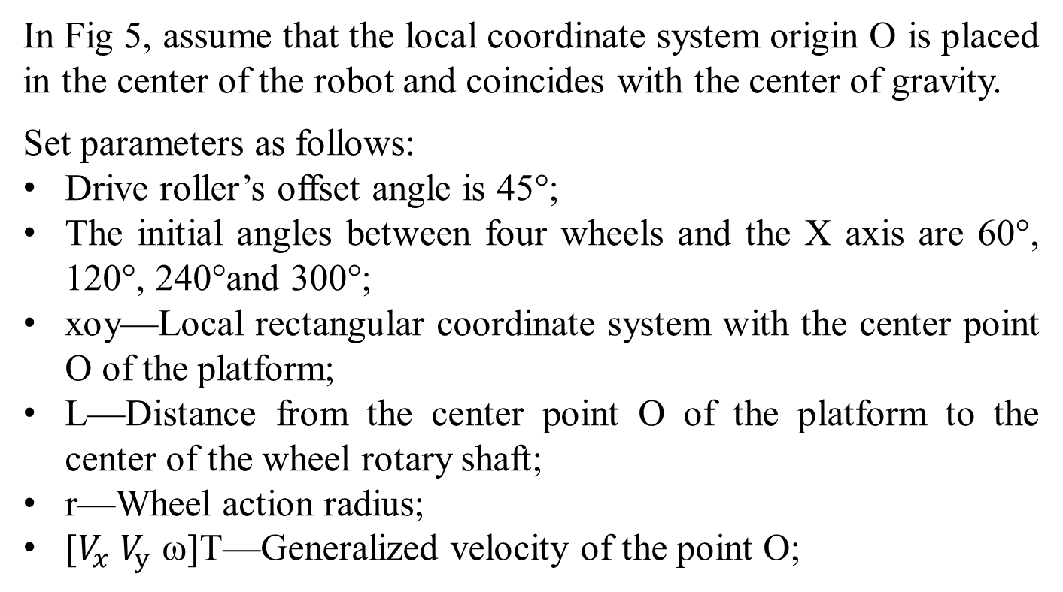
2.4.1 Dynamic Tutorials: Problem
In Fig 5, assume that the local coordinate system origin O is placed in the center of the robot and coincides with the center of gravity.
Set parameters as follows:
Drive roller’s offset angle is 45°;
The initial angles between four wheels and the X axis are 60°, 120°, 240°and 300°;
xoy—Local rectangular coordinate system with the center point O of the platform;
L—Distance from the center point O of the platform to the center of the wheel rotary shaft;
r—Wheel action radius;
[$V_{x}$ $V_{y}$ ω]T—Generalized velocity of the point O;

Slide 9
2.4.2 Dynamic Tutorials: Solution
Derive the dynamics for the robot shown in Fig.1 using any method that you are comfortable with and compare.
Displacements: and
Forces: and
Masses: and
Fig. 1

Slide 10
2.4.2 Dynamic Tutorials: Solution
Two-link Cartesian Robot
Joint: Prismatic
Displacements: and
Forces: and
Masses: and
Fig. 1

Slide 11
2.4.2 Dynamic Tutorials: Solution
Method 1: Euler Newton Method – piece of cake!
Method 2: Lagrange Formulation
The key points are as follows.
All Christoffel Symbols are zero.
C = ??
const. (special case)

Slide 12
2.4.2 Dynamic Tutorials: Solution
Potential energy
Dynamic equation

Slide 13
2.4.2 Dynamic Tutorials: Solution
2. Suppose the robot is under the influence of gravitational acceleration. Assume the mass of each link is lumped at end of the link. Under the assumption of lumped equivalent masses, derive the Dynamic equation using any method you feel comfortable with.
Fig. 2

Slide 14
2.4.2 Dynamic Tutorials: Solution
Hint:
Find the positions and velocities of and with respect to the base xyz
b) Find the kinetic energy K and the potential energy P
Find the expression for matrix from
Find the Lagrange-Euler Equations
where

Slide 15
2.4.2 Dynamic Tutorials: Solution
Step (a)
Pos:
Vel:

Slide 16
2.4.2 Dynamic Tutorials: Solution
Step (b)
Step (c)
Can’t use König's theorem, because we don’t know the moment of inertia of each link.

Slide 17
2.4.2 Dynamic Tutorials: Solution
Step (d): The Christoffel Symbols

Slide 18
2.4.2 Dynamic Tutorials: Solution
Step (e): The Generalized Torque Vector
The work done by and is as follows
Then the generalized torque vector is

Slide 19
2.4.2 Dynamic Tutorials: Solution
3. Suppose the robot is under the influence of gravitational acceleration. Assume the mass of each link is lumped at the centre of the link. r_{i} denotes the distance from joint i to the centre of mass of link, and l_{i} denotes the length of link i. Under the assumption of lumped equivalent masses, derive the Dynamic equation using any method you feel comfortable with.
Fig. 3

Slide 20
2.4.2 Dynamic Tutorials: Solution
Step (a)
Pos:
Vel:

Slide 21
2.4.2 Dynamic Tutorials: Solution
Step (b)
See König's theorem (kinetics)

Slide 22
2.4.2 Dynamic Tutorials: Solution
Step (c)

Slide 23
2.4.2 Dynamic Tutorials: Solution
Step (d): The Christoffel Symbols

Slide 24
2.4.2 Dynamic Tutorials: Solution
Step (e): The Generalized Torque Vector
The work done by and is as follows
Then the generalized torque vector is

Slide 25
2.4.2 Dynamic Tutorials: Solution
4. Consider the 2 link robot in 3D space, assume that the mass of each link is lumped at end of the link.
i) Under the assumption of lumped equivalent masses, derive the dynamics of equation.
ii) Is there any possible configurations for 2 link robots?
iii) Can you image the complexity of higher degree of freedom robots?
Fig. 4

Slide 26
2.4.2 Dynamic Tutorials: Solution
Step (a)
Position and velocity of
Position and velocity of
Notes:
原来里面不是 3 4 open 这里是5 ？

Slide 27
2.4.2 Dynamic Tutorials: Solution
Step (b)
Step (c): The potential energy
Step (d): The dynamics are given by

Slide 28
2.4.2 Dynamic Tutorials: Solution
Therefore
Since the work done by and is
then, the generalized torque vector

Slide 29
2.4.2 Dynamic Tutorials: Solution
Equivalent Mass and Steiners’ Theorem
Fig. 6

Slide 30
2.4.2 Dynamic Tutorials: Solution
In fact, as stated in Steiners’ Theorem
The energy can be further written in the equivalent mass as:

Slide 31
2.4.1 Dynamic Tutorials: Problem
5. For the differential driven wheeled robot shown in Figure 5, where each wheel is driven independently. Forward/backward motion is produced by driving both wheels at the same rate, and turning right/left is achieved by driving the wheels at different rates.
$$ω_{1}$$
$$ω_{2}$$
(i) Give two different sets of generalized coordinates for the robot, and clearly indicate the type of joints.
$$ω$$
$$ω_{3}$$
$$ω_{4}$$
Fig. 5
(ii) Find its kinetic energy, and Langrange-Euler equations.

Slide 32
2.4.1 Dynamic Tutorials: Problem
In Fig 5, assume that the local coordinate system origin O is placed in the center of the robot and coincides with the center of gravity.
Set parameters as follows:
Drive roller’s offset angle is 45°;
The initial angles between four wheels and the X axis are 60°, 120°, 240°and 300°;
xoy—Local rectangular coordinate system with the center point O of the platform;
L—Distance from the center point O of the platform to the center of the wheel rotary shaft;
r—Wheel action radius;
[$V_{x}$ $V_{y}$ ω]T—Generalized velocity of the point O;

Slide 33
2.4.2 Dynamic Tutorials: Solution
Step (a)
The inverse kinematic analysis result of driven wheeled robot structure is showed.

Slide 34
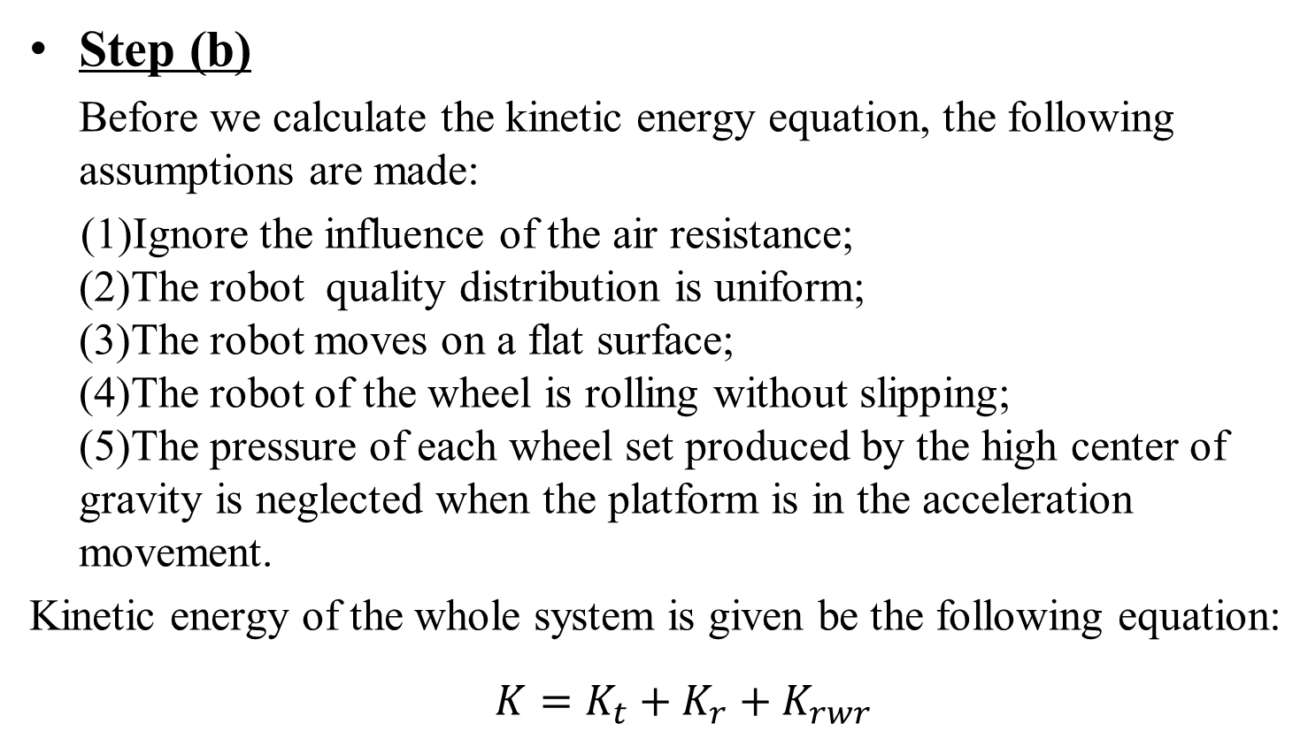
2.4.2 Dynamic Tutorials: Solution
Step (b)
Before we calculate the kinetic energy equation, the following assumptions are made:
(1)Ignore the influence of the air resistance; (2)The robot quality distribution is uniform; (3)The robot moves on a flat surface; (4)The robot of the wheel is rolling without slipping; (5)The pressure of each wheel set produced by the high center of gravity is neglected when the platform is in the acceleration movement.
Kinetic energy of the whole system is given be the following equation:
$K=K_{t}+K_{r}+K_{rwr}$

Slide 35
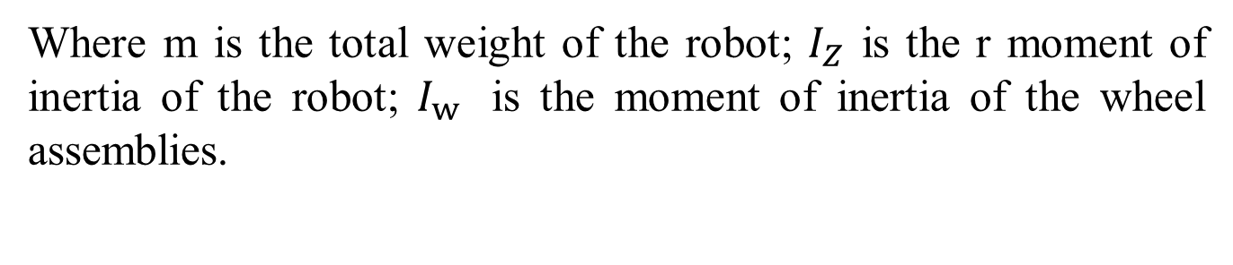
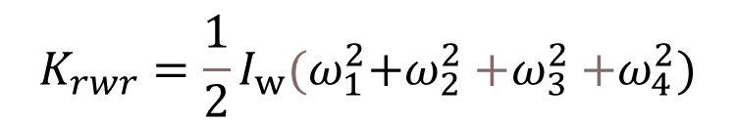


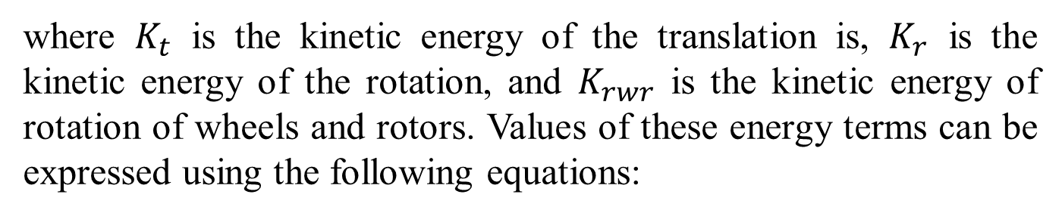
2.4.2 Dynamic Tutorials: Solution
where $K_{t}$ is the kinetic energy of the translation is, $K_{r}$ is the kinetic energy of the rotation, and $K_{rwr}$ is the kinetic energy of rotation of wheels and rotors. Values of these energy terms can be expressed using the following equations:
$$K_{t}=\frac{1}{2}mv_{c}^{2}=\frac{1}{2}m\left(V_{x}^{2}+V_{y}^{2}\right)$$
$$K_{r}=\frac{1}{2}I_{Z}ω^{2}$$
$$K_{rwr}=\frac{1}{2}I_{w}{(ω}_{1}^{2}+ω_{2}^{2}{+ω}_{3}^{2}{+ω}_{4}^{2})$$
Where m is the total weight of the robot; $I_{Z}$ is the r moment of inertia of the robot; $I_{w}$ is the moment of inertia of the wheel assemblies.

Slide 36
2.4.2 Dynamic Tutorials: Solution
From the Lagrange equation:
where
From Step (a) , total kinetic energy of the mobile robot can be calculated

Slide 37
2.4.2 Dynamic Tutorials: Solution
Then
Finally, dynamic equation can be expressed as:

Slide 38
2.4.3 Simulation Example 1
The simulation using the Simple Integration Method is conducted on the two-link planar robot
Given initial conditions , , we have
Fig. 7

Slide 39
2.4.3 Simulation Example 1
Main code for simulation
clc; clear all; format long; n=2;
q0=[pi/3;pi/6]; % initial position
dq0=zeros(n,1); %zero initial velocity
T=10; q(:,1)=q0; dq(:,1)=dq0;
h=0.01; %%%sampling gap
i=1;
for t=0:h:T
tao = [0.01 + 0.01 * sin(2*t); 0.02 + 0.01 * cos(t)]; % given torque
[D,C,G] = Dynamic_model(q(:,i),dq(:,i)); ID = inv(D);
ddq(:,i) = ID * (tao - C * dq(:,i) -G);
dq(:,i+1) = dq(:,i) + ddq(:,i) * h;
q(:,i+1) = q(:,i) + dq(:,i) * h + (1/2) * ddq(:,i) * h * h;
i=i+1;
end

Slide 40
2.4.3 Simulation Example 1
Code for dynamic model
function [D,C,G]=Dynamic_model(q,dq)
len=[0.5;0.7]; l1=len(1); l2=len(2);
mass=[0.2,0.3]; m1=mass(1);m2=mass(2); g=9.8;
D=zeros(2,2); C=zeros(2,2); G=zeros(2,1);
D(1,1) = m1*l1*l1 + m2*l1*l1 + m2*l2*l2 + 2*m2*l1*l2*cos(q(2));
D(1,2) = m2*l2*l2 + m2*l1*l2*cos(q(2));
D(2,1) = m2*l2*l2 + m2*l1*l2*cos(q(2));
D(2,2) = m2*l2*l2;
C(1,1) = -(m2*l1*l2*sin(q(2))*dq(2));
C(1,2) =- (m2*l1*l2*sin(q(2))*dq(1))-(m2*l1*l2*sin(q(2))*dq(2));
C(2,1) = (m2*l1*l2*sin(q(2))*dq(1));
C(2,2) = 0;
G(1) = (m1*l1+m2*l1)*g*cos(q(1)) + m2*l2*g*cos(q(1)+q(2));
G(2) = m2*l2*g*cos(q(1)+q(2));

Slide 41
2.4.3 Simulation Example 1

